Slide 1
Roblox Workforce Analytics
Data Analytics Upskill Capstone Project
| August 2026

Slide 2
Introduction: Business Context and Problem
Roblox leadership lacks a single, unified view of how workforce decisions affect employee wellbeing, organizational performance and cost efficiency.
Current Situation
Workforce data is stored separately across HR, Finance, Health Administration, Employee Performance and Department Performance systems.
Business Impact
This fragmentation makes it difficult to:
Understand total workforce costs and staffing efficiency.
Assess whether employee qualifications align with job placement.
Monitor employee wellbeing and benefits-related risks.
Make evidence-based hiring, promotion and budgeting decisions.
Integrate the available workforce datasets into one analytical view that provides leadership with clear insights and actionable recommendations.
| Group 1

Slide 3
Overview
01
03
Business Objectives
02
Dashboard Findings
04
The purpose, expected outcomes and success criteria of the workforce analysis
Workforce, education, compensation, performance, wellbeing and department results
Workforce Structure
Implications & Action
The scope of the workforce, performance and financial evidence
Key management implications, recommendations and the proposed 90-day action plan
| Group 1

Slide 4
Business Objectives
Primary Objective
Develop an integrated workforce analysis that enables leadership to evaluate organizational performance, employee wellbeing and cost efficiency across departments.
Other Objectives
Success Criteria
Analyse workforce composition by department, position, gender and employment status.
Assess the alignment between employee education and job placement.
Evaluate compensation patterns and workforce cost distribution.
Identify performance, benefits and wellbeing-related operational risks.
Provide actionable recommendations for workforce sustainability and efficiency
Provide a unified and reliable workforce view.
Produce insights linked directly to business decisions.
Identify clear improvement opportunities.
Support better workforce planning and budgeting.
Maintain a reproducible and documented analysis.
Establish a foundation for future predictive analytics.

Slide 5
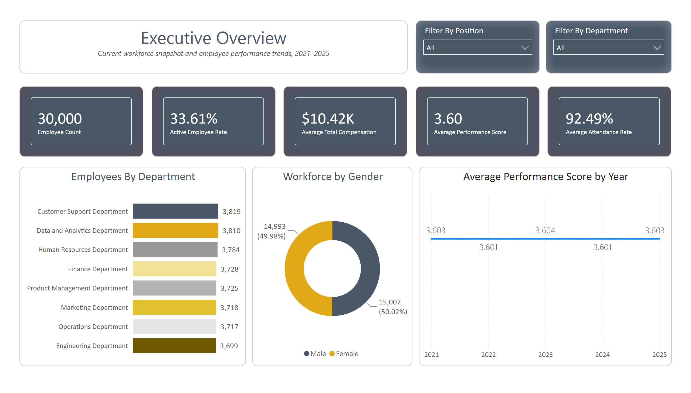

Slide 6
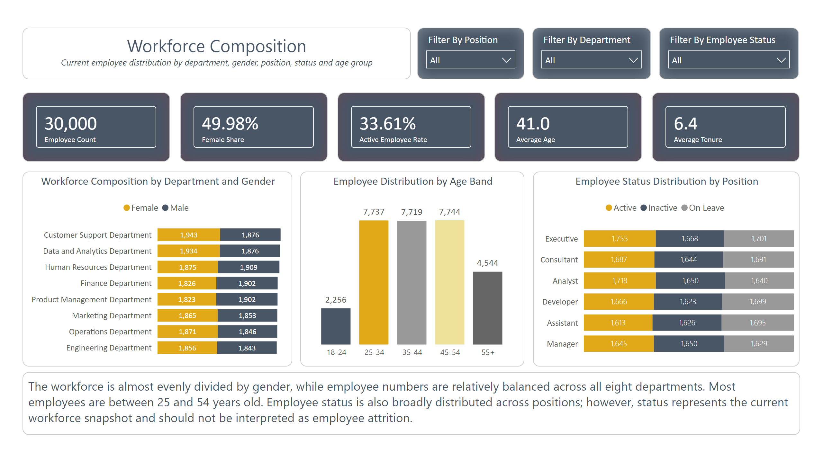

Slide 7
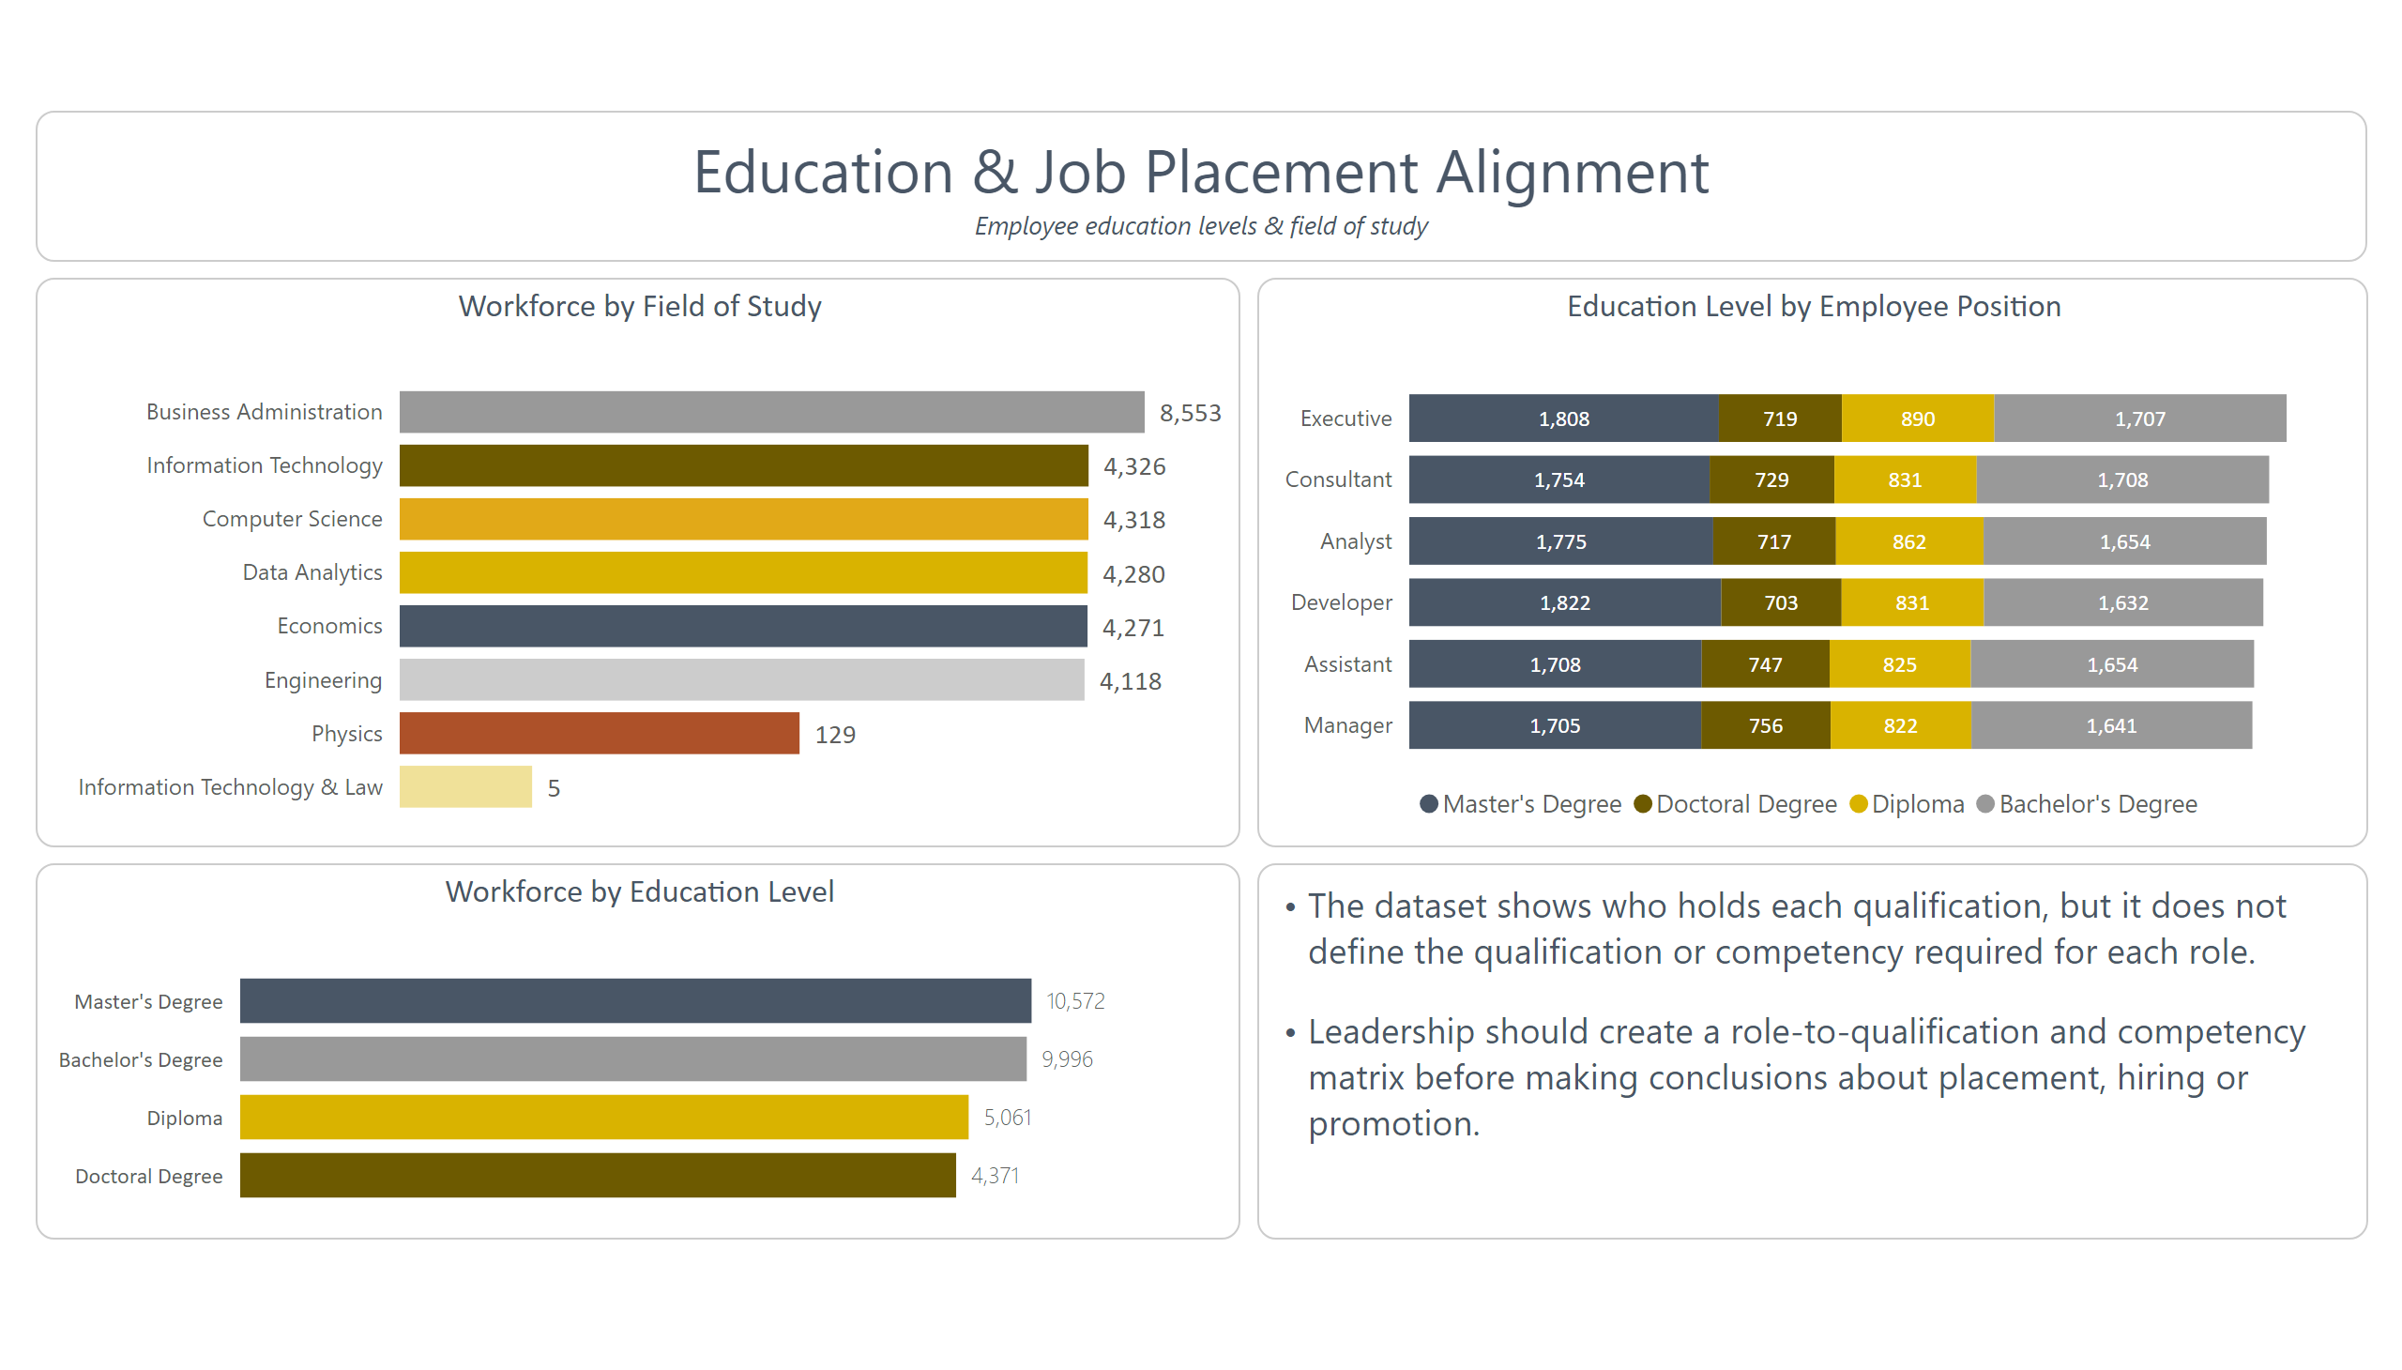

Slide 8
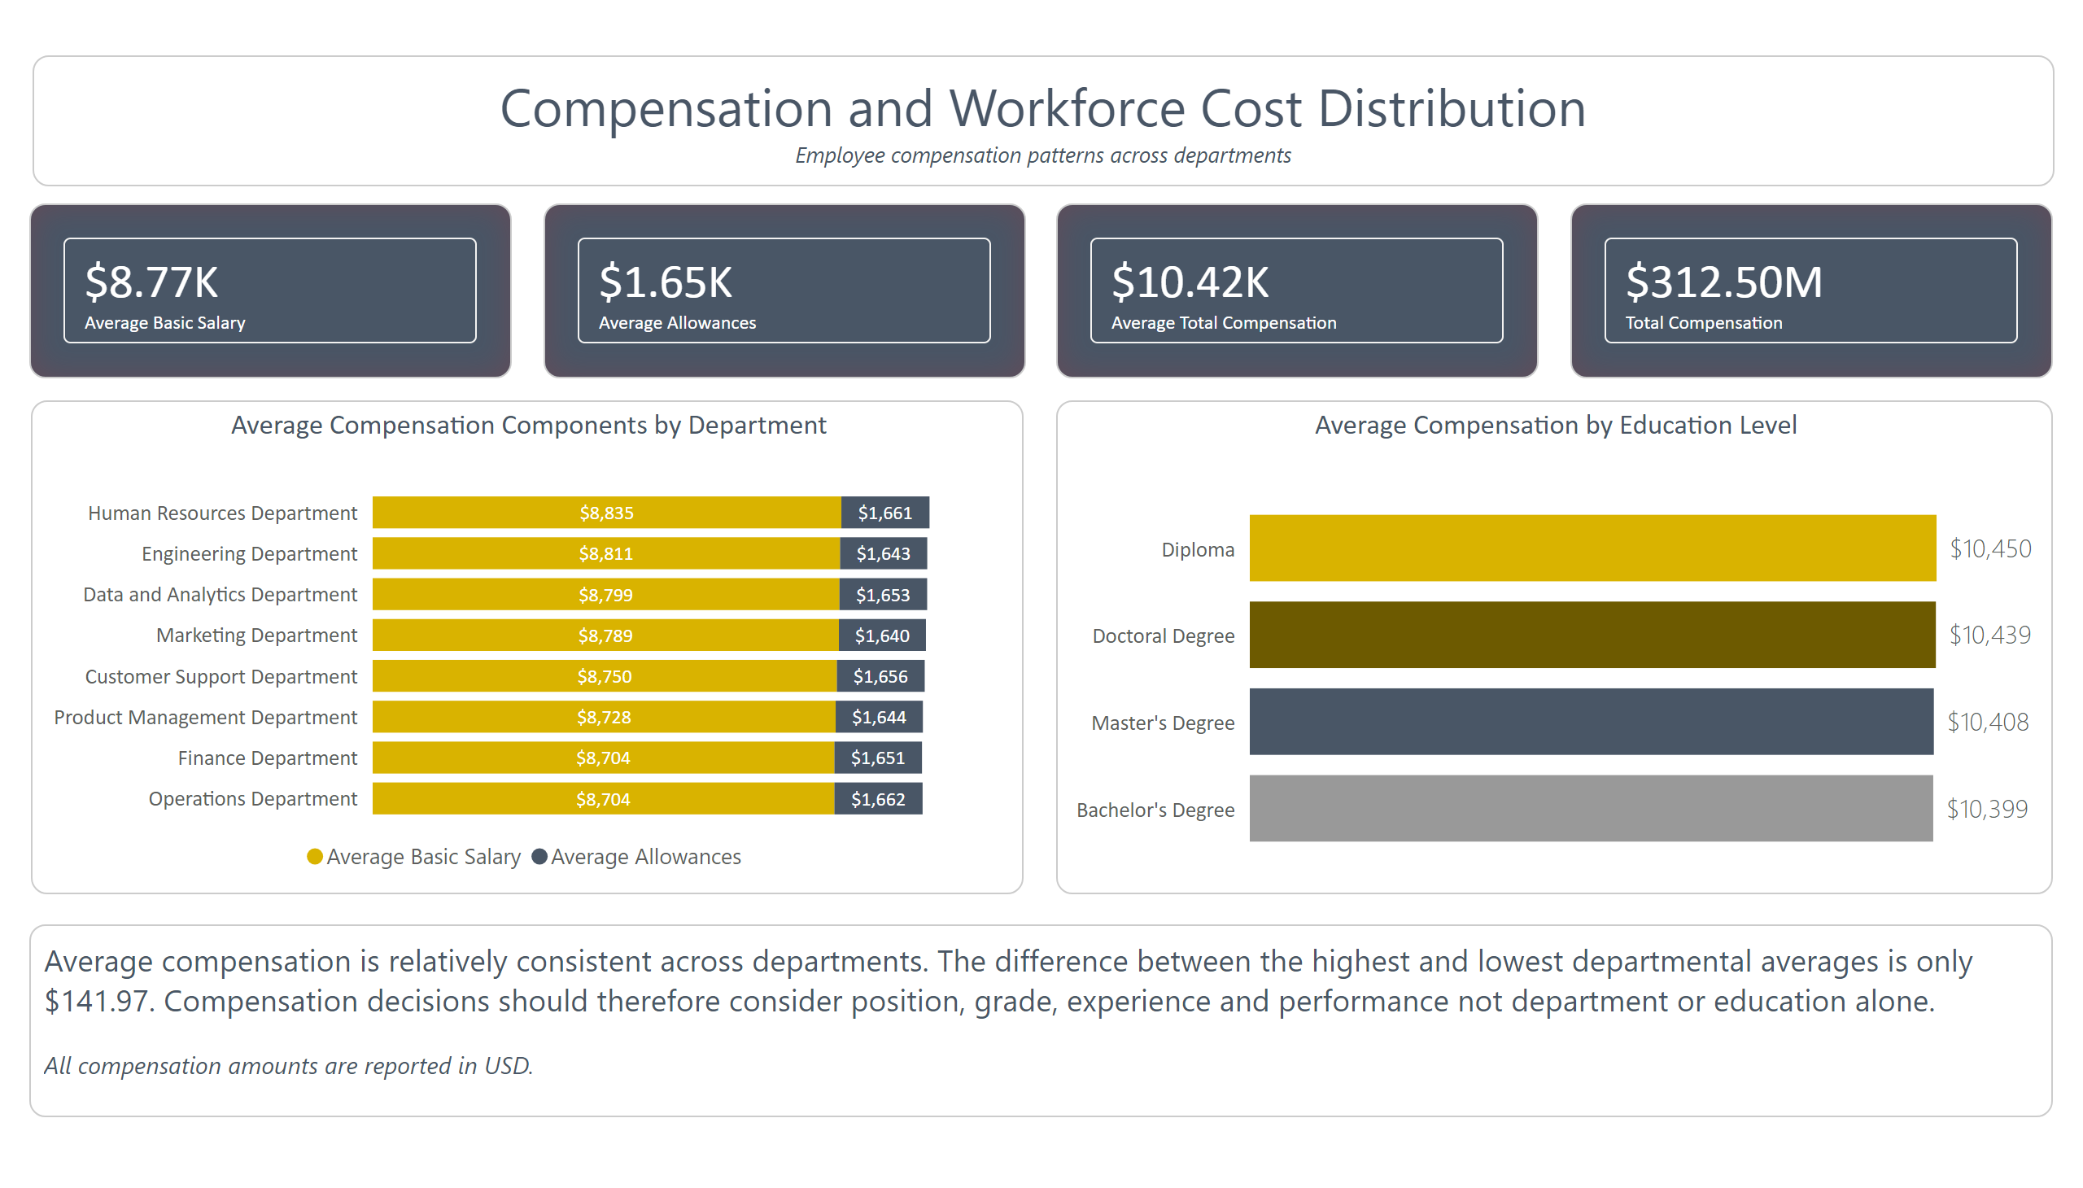

Slide 9
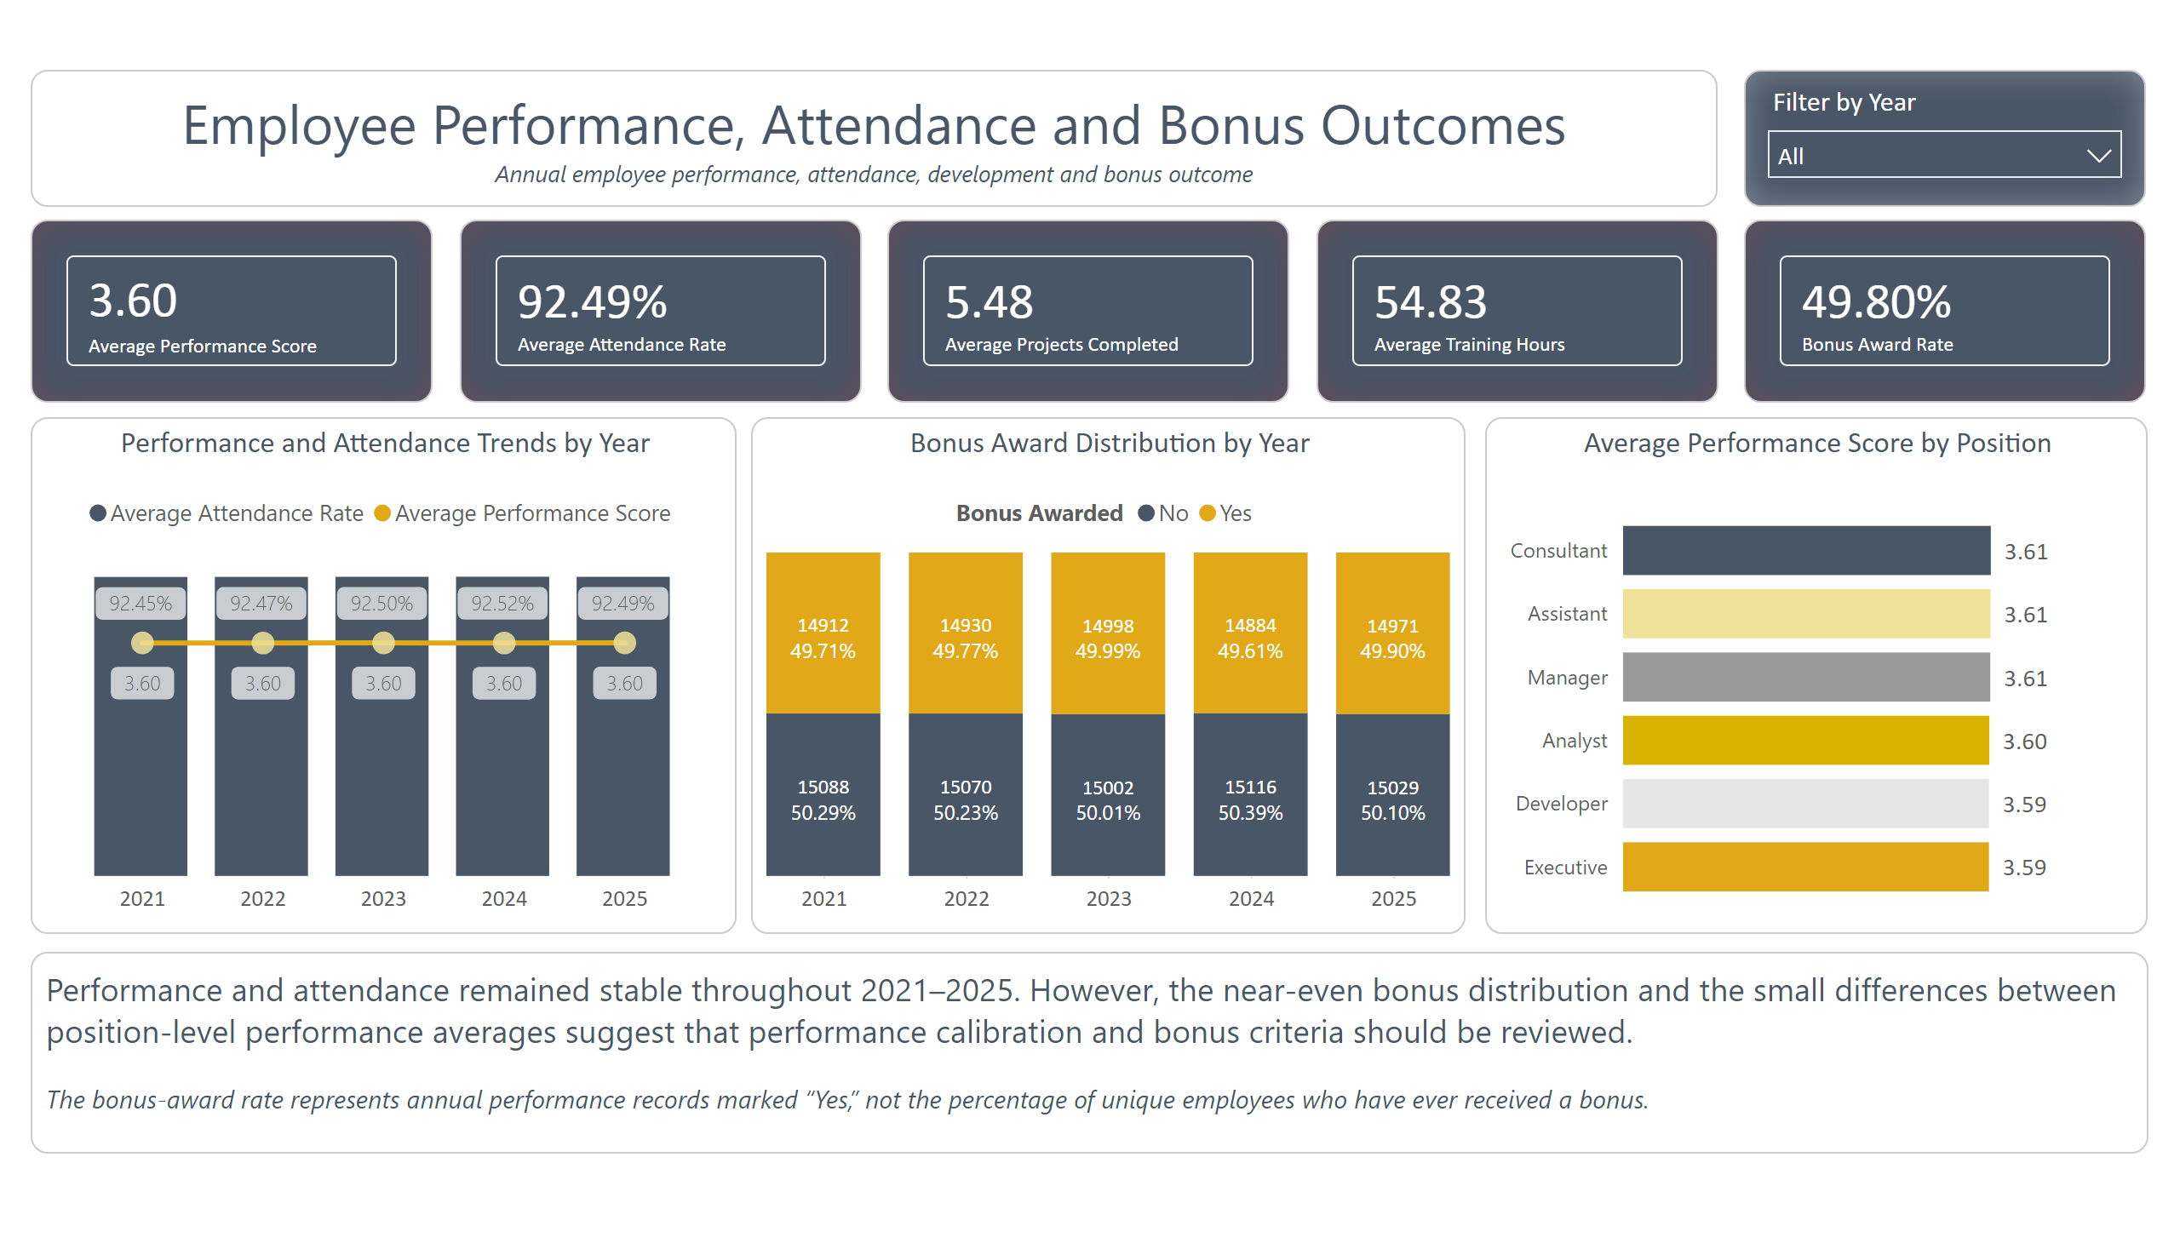

Slide 10
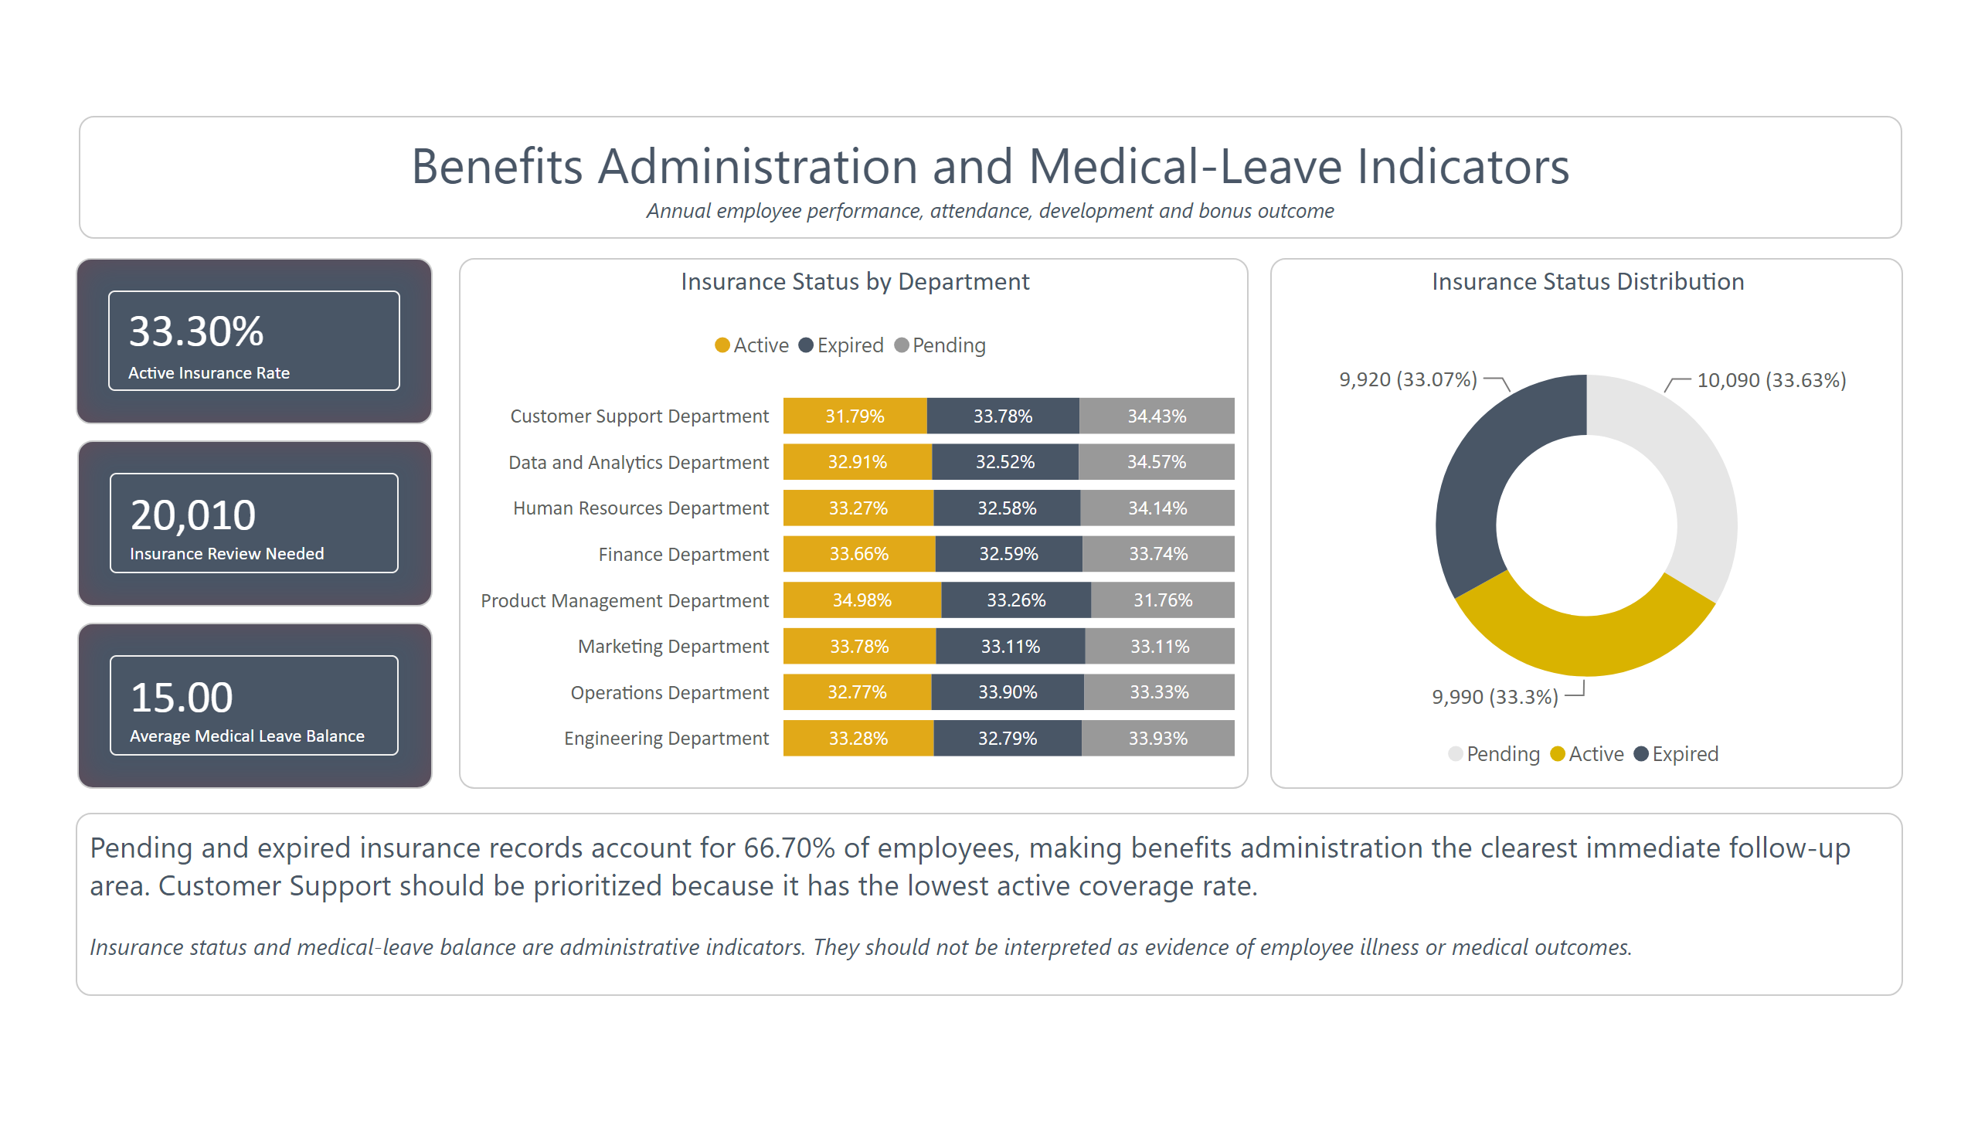

Slide 11
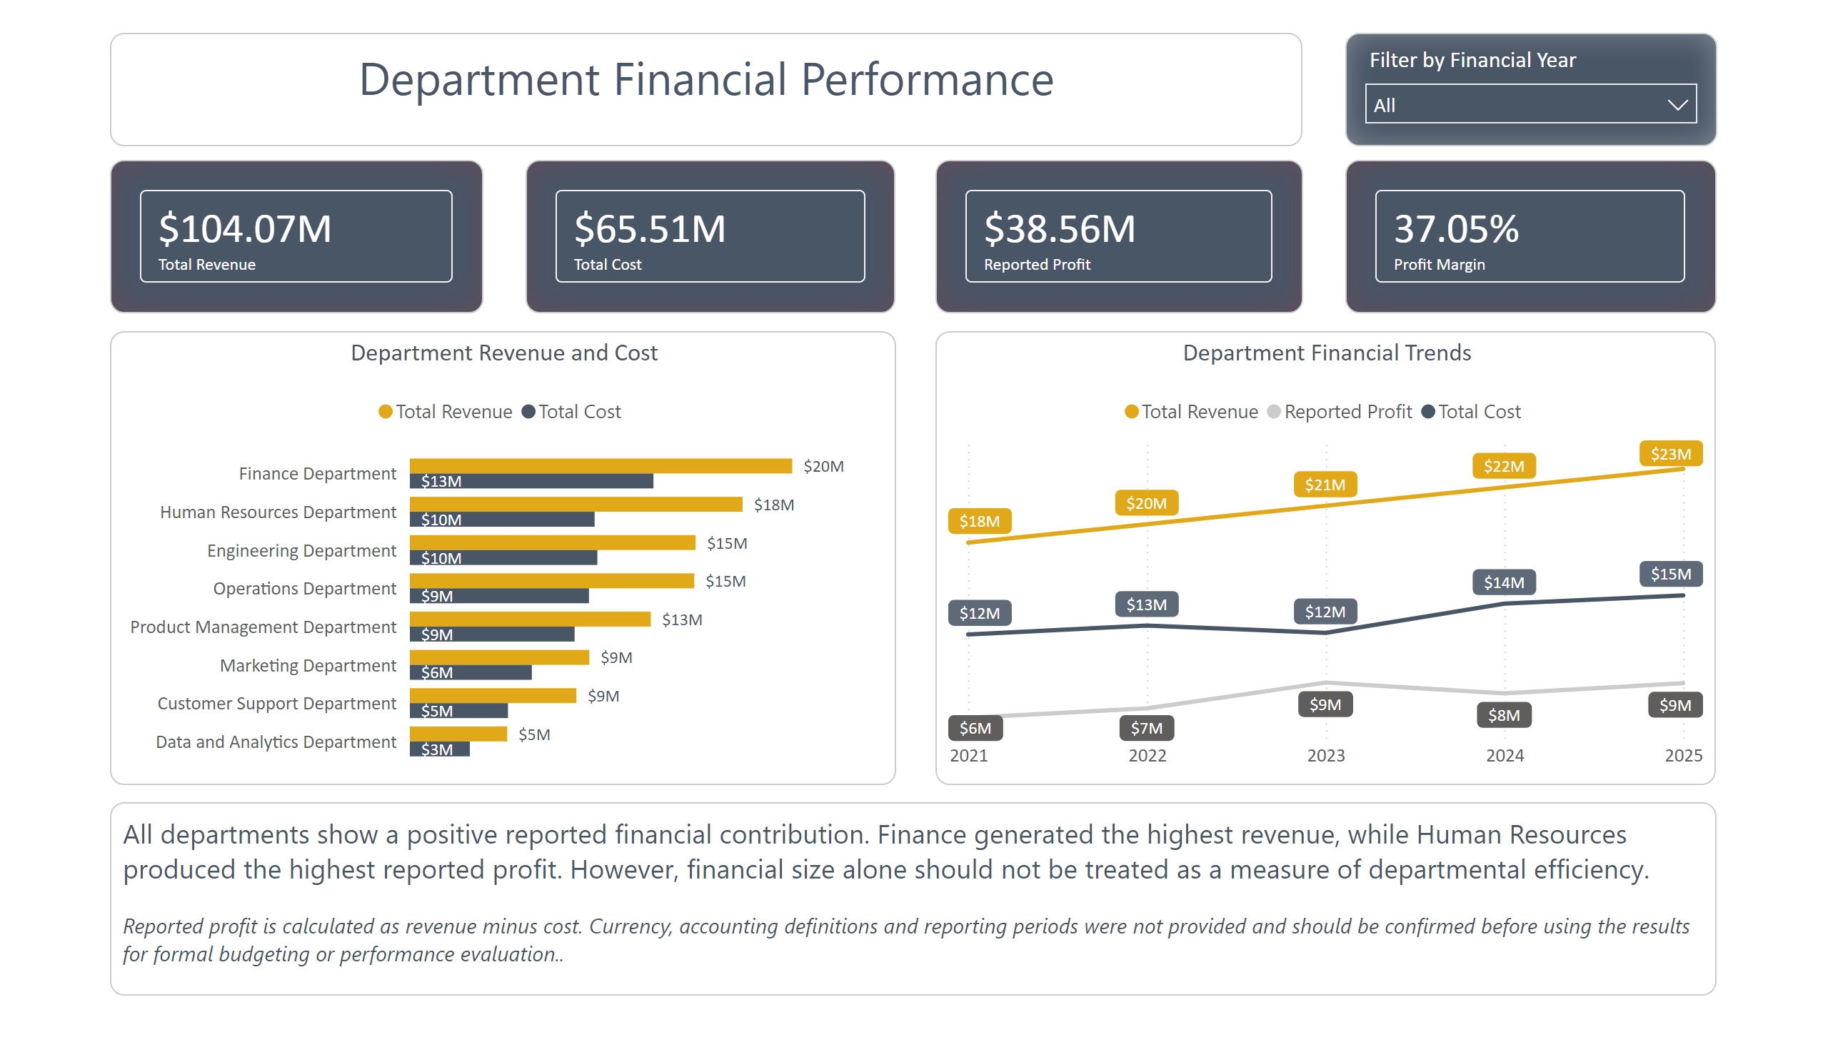

Slide 12
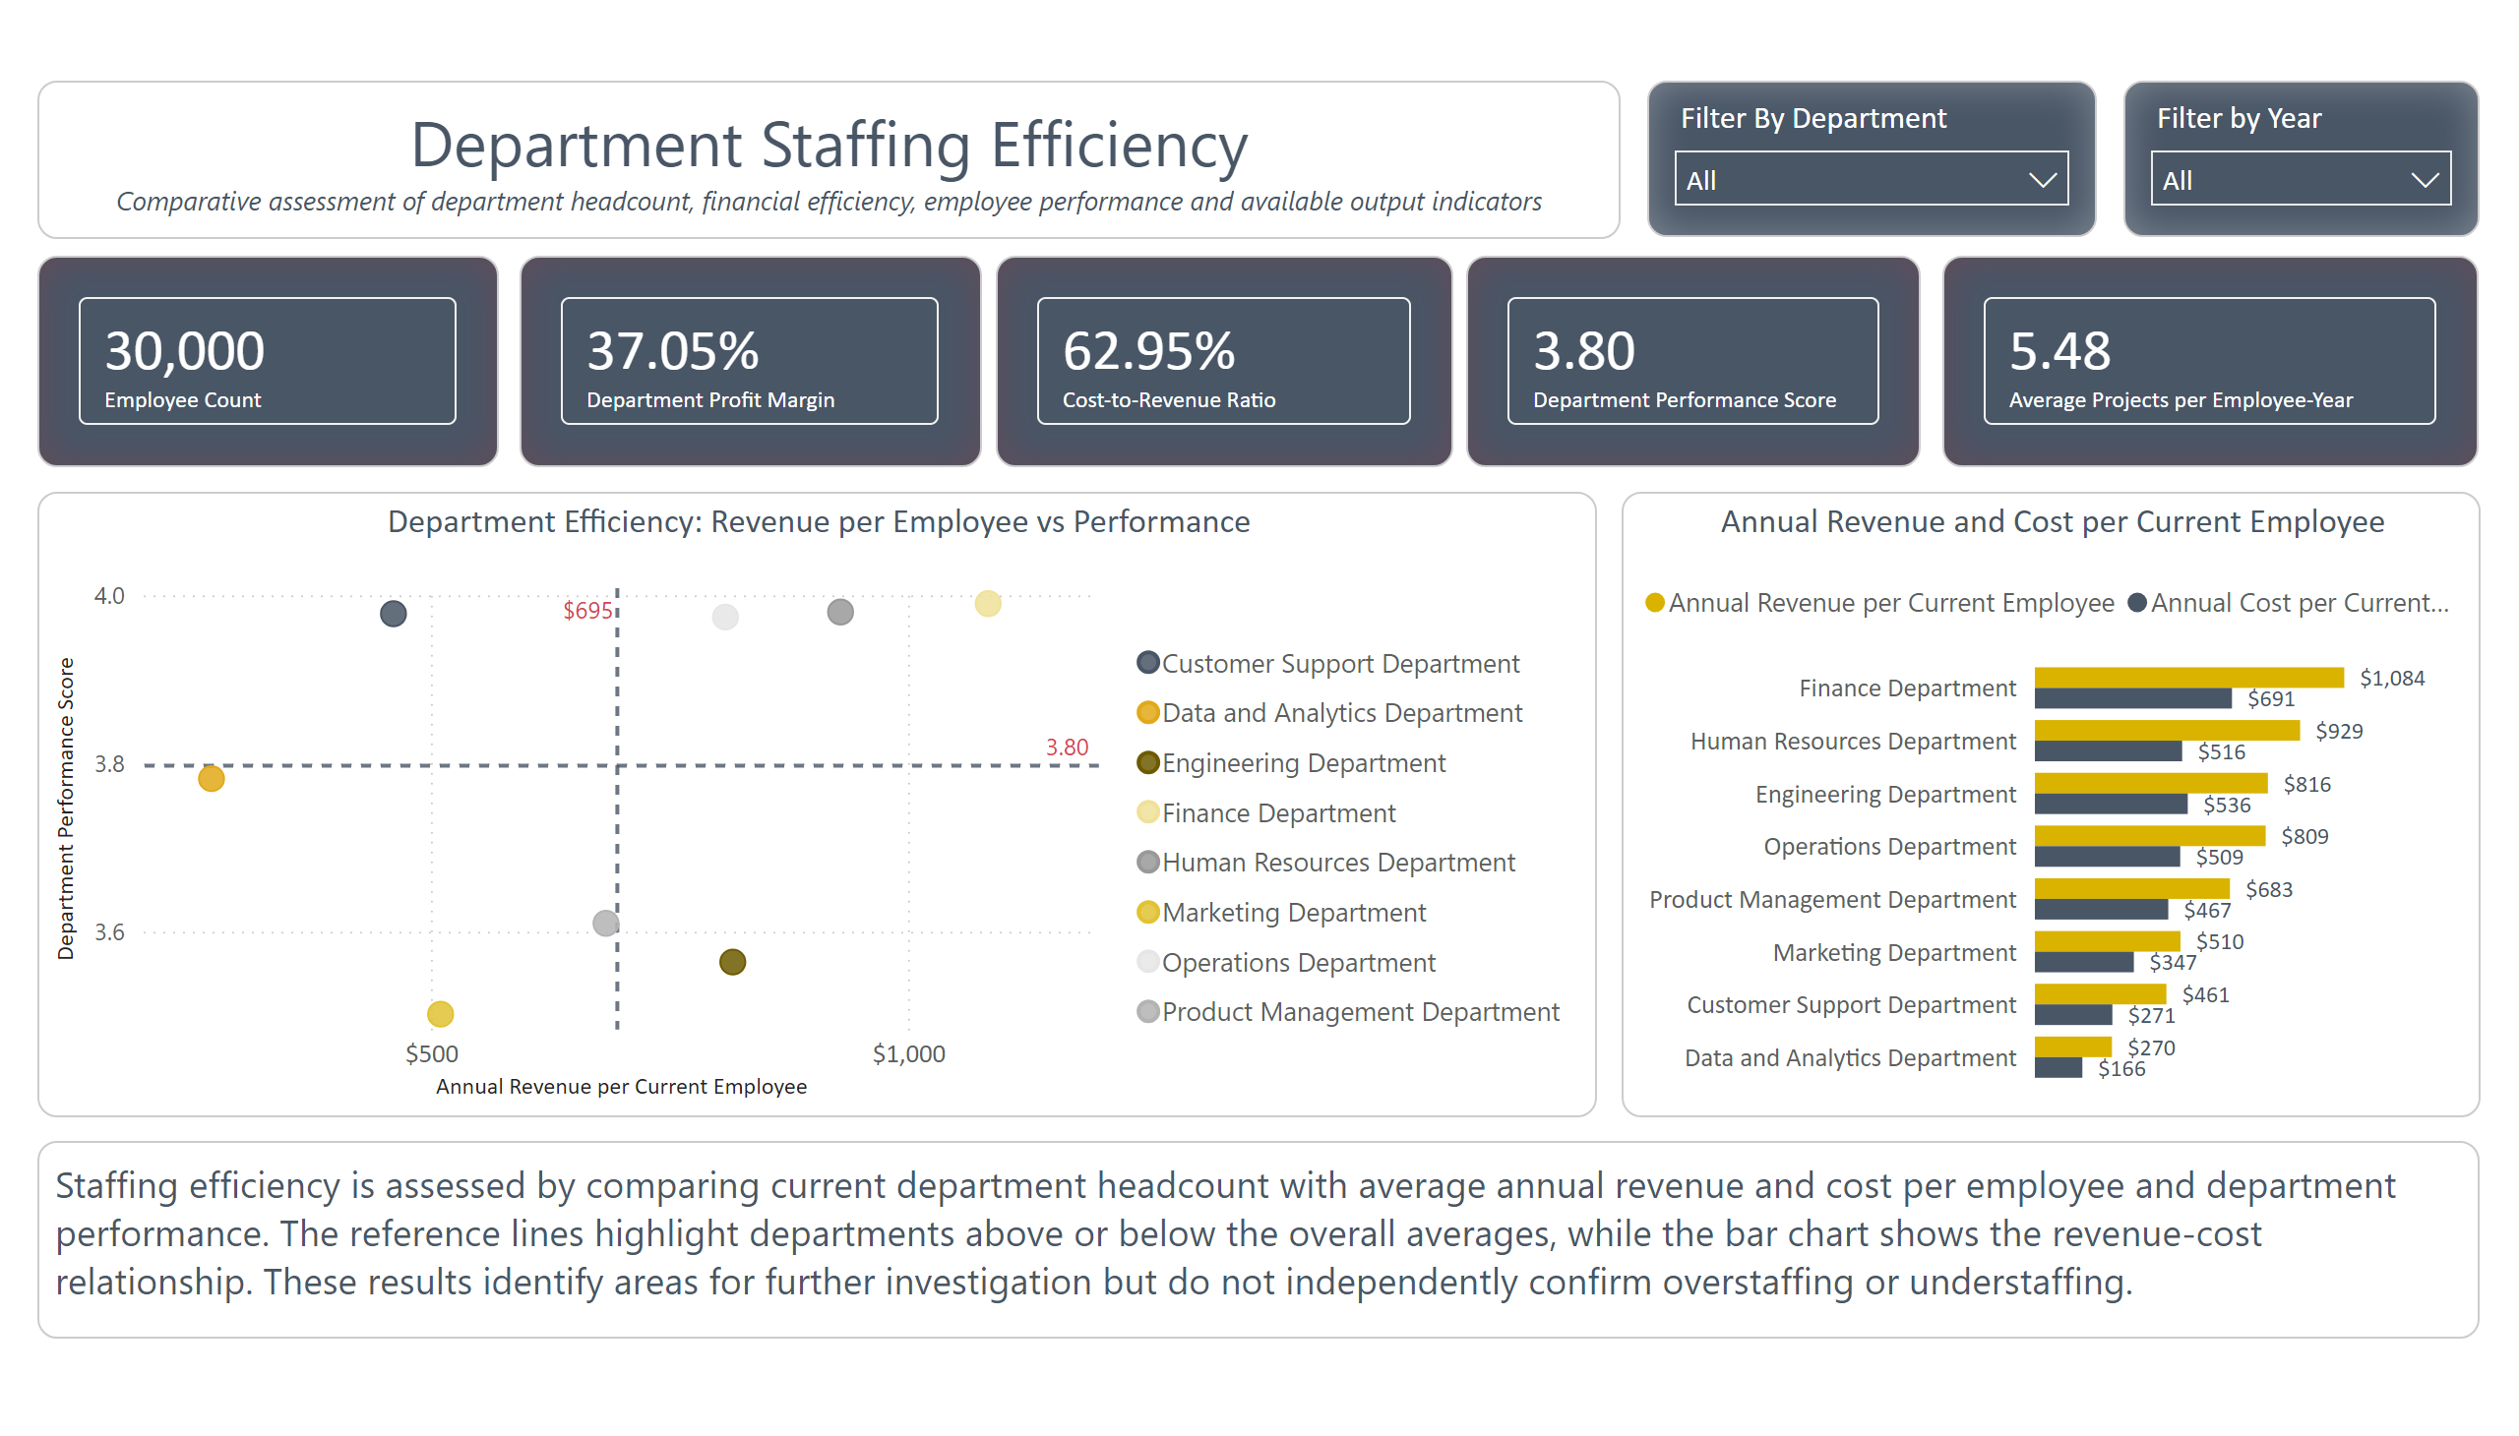

Slide 13
Management Implications & Actions
Evidence from the Analysis | Management Implication | Required Management Action
66.4% of employees are recorded as On Leave or Inactive | The recorded employee count may not represent the currently available or payroll-eligible workforce. | Reconcile employee-status definitions, effective dates and payroll eligibility.
20,010 insurance records are Pending or Expired | A significant number of employee benefit cases may require administrative follow-up. | Prioritize insurance reconciliation by department, beginning with Customer Support.
Performance remains around 3.60, while bonuses remain close to 50% annually | Performance ratings and bonus outcomes may not strongly differentiate employee contribution. | Review performance calibration and bonus criteria across comparable roles.
Education and compensation differences are relatively small across groups | Qualifications or department alone should not determine placement, promotion or compensation. | Develop role, competency, qualification and salary-grade standards.
Department efficiency varies across revenue per employee and performance measures | The comparisons identify departments for further investigation but do not independently prove overstaffing or understaffing. | Review workload, service demand, staffing capacity, historical headcount and financial definitions before making staffing changes.

Slide 14
90-day Action Plan
Priority Action | Owner | Timing
Reconcile employee status and payroll eligibility | HR Operations and Finance | 0–30 days
Resolve Pending and Expired insurance records | Benefits and HRIS | 0–45 days
Review performance calibration and bonus criteria | People Analytics and Rewards | 0–75 days
Create a role and qualification matrix | Talent and Department Leads | 30–90 days
Validate department workload, staffing capacity and financial definitions | HR Analytics, Finance and Department Leads | 30–90 days

Slide 15
Conclusion
Overall Conclusion
The integrated analysis provides leadership with a unified view of 30,000 employees across eight departments. The workforce is broadly balanced, and performance remained stable between 2021 and 2025. However, the analysis also identifies important gaps in benefits administration, employee-status definitions, performance calibration and financial-data governance.
Key Takeaways
Workforce structure is balanced, but department efficiency varies
Department sizes are similar, while performance and annual revenue per employee differ. Outlying departments should be investigated before staffing decisions are made.
Benefits administration requires immediate attention
20,010 insurance records are Pending or Expired and should be reviewed, beginning with departments that have the lowest active coverage.
Stronger governance is required for major decisions
Clear role standards, performance definitions, bonus criteria and financial reporting rules are needed before making major hiring, promotion or budgeting decisions.

Slide 16
Questions & Discussion

